Slide 1
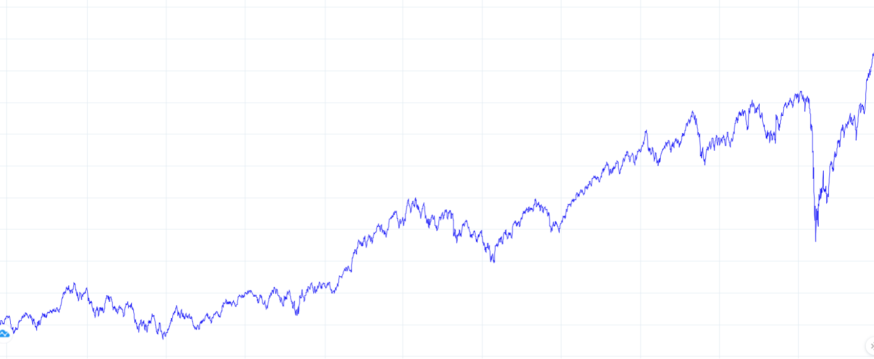
STOCKS ANALYSIS (Research Project by- ABHISHEK GULATI)
Top Ranked Data Science & Analytics Education Provider since 2007

Slide 2

CONTENTS
INTRODUCTION AND CASE STUDY
OBJECTIVE
DATA ANALYSIS
INSIGHTS

Slide 3

CASE STUDY
Data Source - https://www.kaggle.com/datasets/rohanrao/nifty50-stock-market-data
This Case Study contains 3 datasets
Attributes (Same in all Dataset) – Date, Symbol, Open, High, Low, Close, Volume
Data in datasets is from 2010-01-04 – 2021-04-30
1st Dataset - UltraTech Cement
2nd Dataset – Maruti Suzuki
3rd Dataset – Bharti Airtel

Slide 4


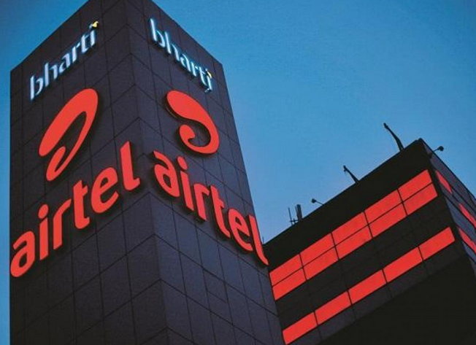

OBJECTIVE
Analyse UltraTech Cement Ltd, Maruti Suzuki Ltd and Bharti Airtel Ltd on these parameters -
Volatility
Drawdown percentage (Time Frame - 2020-02-20 and 2020-03-23)
Recovery days (Post covid fall)
Number of days stock price closed above its previous day’s close
CAGR (Returns)
Highest Volume Month
Scoring based on the above criteria

Slide 5
BHARTI AIRTEL LIMITED
Bharti Airtel Limited is a leading global telecommunications company
Sunil Bharti Mittal – Chairman
Gopal Vittal – MD & CEO
It is the second largest mobile network operator in India
Operation in 18 countries across Asia and Africa
They had over 403 million customers across its operations at the end of March 2019

Slide 6
ULTRATECH CEMENT LIMITED
UltraTech Cement Limited is an Indian cement company based in Mumbai
It’s the cement flagship company of the Aditya Birla Group
Mr. K. C. Jhanwar – Managing Director
It’s is the largest manufacturer of grey cement, ready-mix concrete (RMC) and white cement in India
It was founded in the year 1983
It is the third largest cement producer in the world, excluding China

Slide 7
MARUTI SUZUKI LIMITED
Maruti Suzuki India Limited (MSIL), a subsidiary of Suzuki Motor Corporation, Japan, is India’s largest passenger car maker.
RC Bhargava - Chairman
The Company has manufacturing facilities in Gurgaon and Manesar in Haryana and a state of the art R&D centre in Rohtak, Haryana.
The Company, formerly known as Maruti Udyog Limited, was incorporated as a joint venture between the Government of India and Suzuki Motor Corporation, Japan in February, 1981
Maruti Suzuki leads the passenger vehicle segment with a market share of 42.53% in December 2021

Slide 8

DATA ANALYSIS

Slide 9
VOLATILITY
Volatility - In finance, volatility is the degree of variation of a trading price series over time (2010-01-04 – 2021-04-30)
Formula Used – Average(Day High – Day Low) over a period of time
INSIGHTS-
Volatility – Lower the better
Bharti Airtel is the least volatile stock
Maruti Suzuki is the most volatile stock

Slide 10
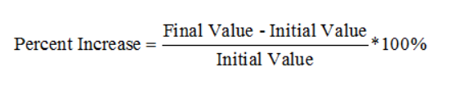
DRAWDOWN/ FALL IN STOCK PRICE, (2020-02-20 - 2020-03-23)
Drawdown - A drawdown refers to how much an investment or trading account is down from the peak before it recovers back to the peak.
Formula Used -
INSIGHTS-
Drawdown – Lower the better
Bharti Airtel has the least Drawdown
Maruti Suzuki has the most Drawdown

Slide 11
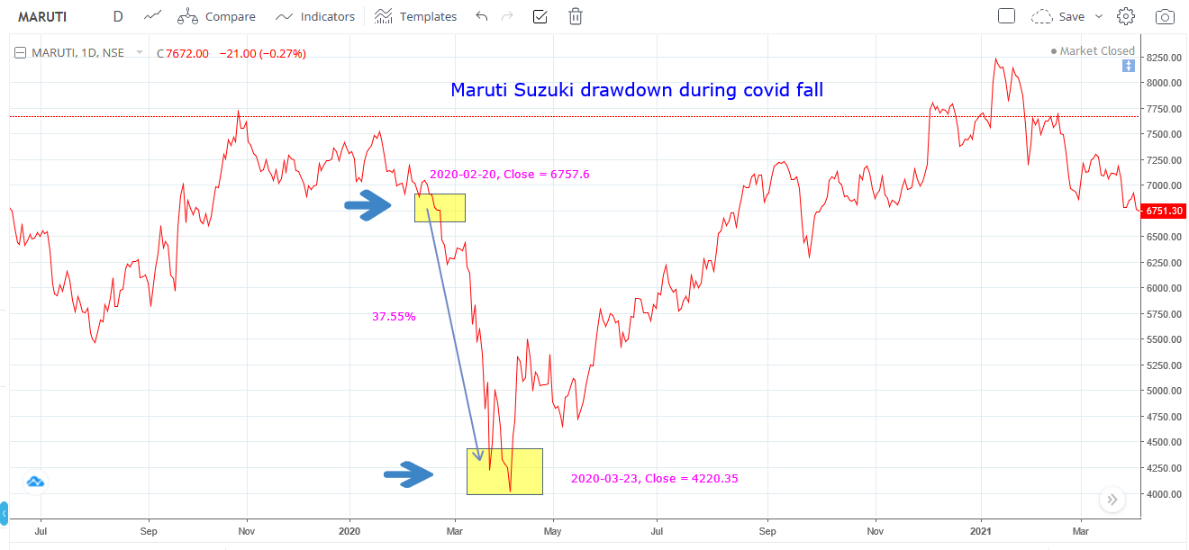
MARUTI SUZUKI DRAWDOWN/ FALL

Slide 12
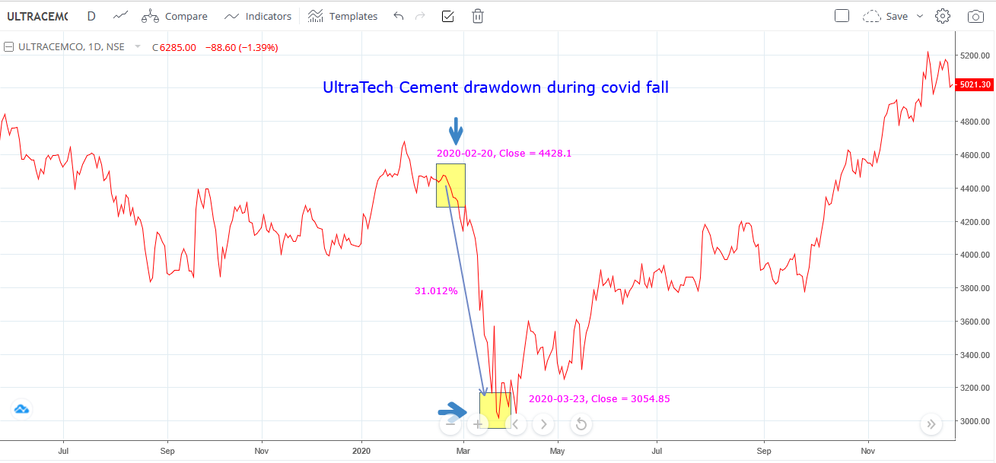
ULTRATECH CEMENT DRAWDOWN/ FALL

Slide 13
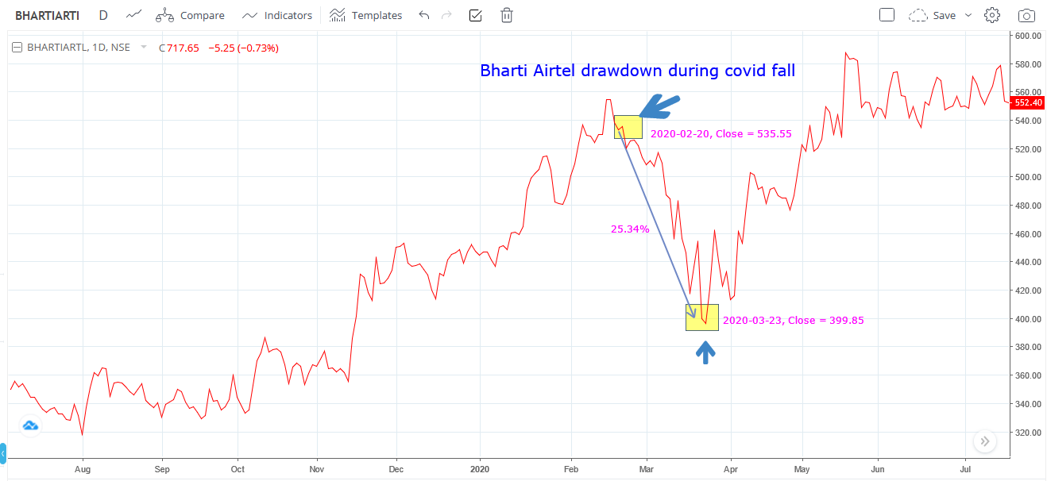
BHARTI AIRTEL DRAWDOWN/ FALL

Slide 14
RECOVERY DAYS (POST COVID FALL)
Recovery Days- Number of days taken by stock to close above it’s pre covid close price
INSIGHTS-
Recovery Days – Lesser the better
Bharti Airtel – Fastest Recovery
UltraTech Cement – Slowest Recovery

Slide 15
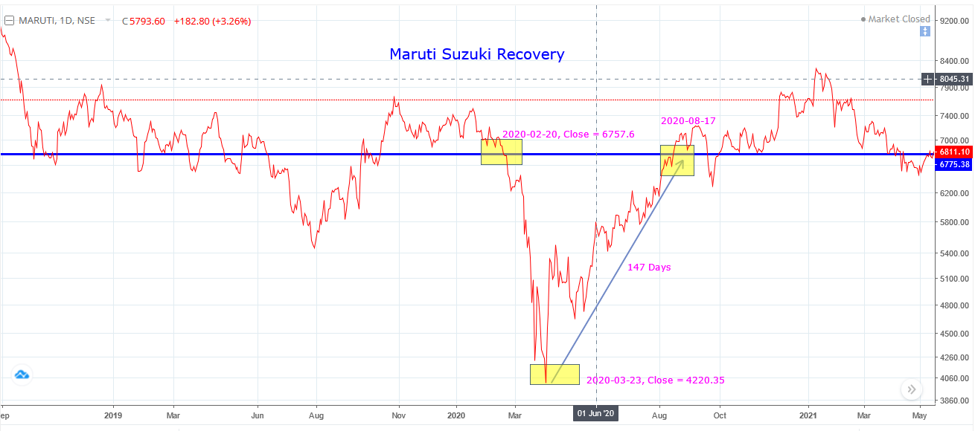
MARUTI SUZUKI RECOVERY DAYS

Slide 16
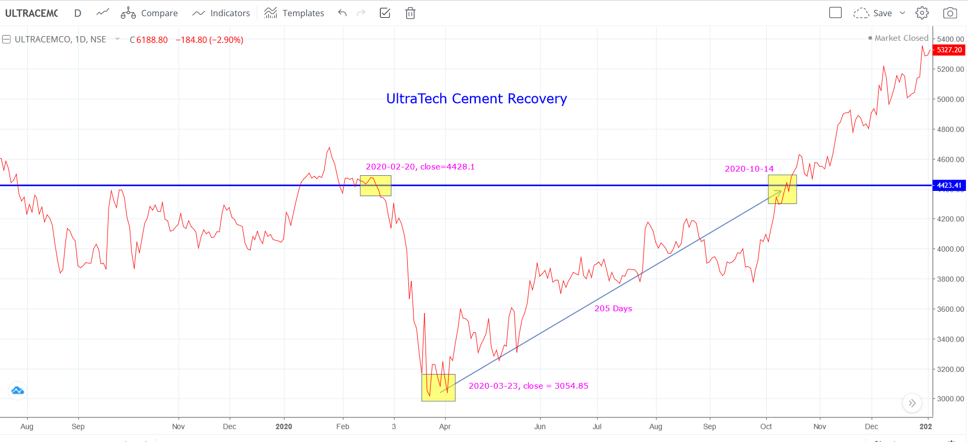
ULTRATECH CEMENT RECOVERY DAYS

Slide 17
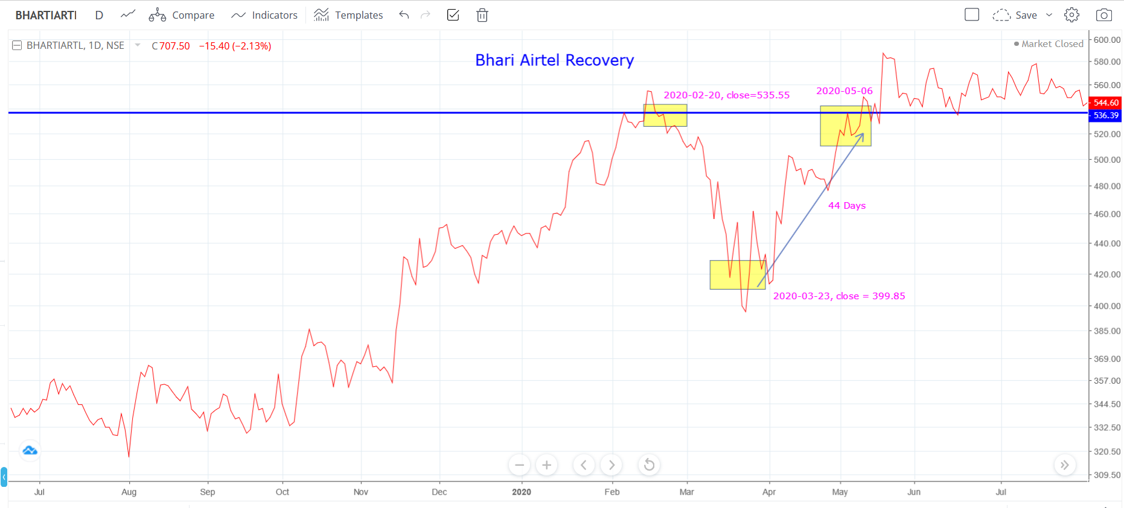
BHARTI AIRTEL RECOVERY DAYS

Slide 18
NUMBER OF DAYS WHEN STOCK PRICE CLOSED ABOVE ITS PREVIOUS DAY CLOSED PRICE (STRENGTH)
INSIGHTS-
Strength – Higher the better
Bharti Airtel – minimum
UltraTech Cement – maximum

Slide 19
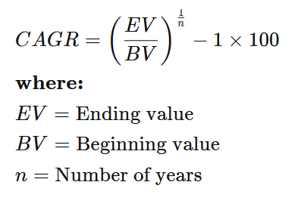
CAGR (COMPOUND ANNUAL GROWTH RATE)
CAGR - The compound annual growth rate (CAGR) is the rate of return (RoR) that would be required for an investment to grow from its beginning balance to its ending balance, assuming the profits were reinvested at the end of each period of the investment’s life span.
Formula -
INSIGHTS-
CAGR – Higher the better
Bharti Airtel – Lowest
UltraTech Cement – Highest

Slide 20
SIMPLE EXPLANANTION OF CAGR
Example –
10% CAGR
100 (Year 0) ------ 110 (Year 1) -------- 121 (Year 2)
10% of 100 10% of 110
--------------------------------------------------------------------------------------------
10% Normal increase
100 (Year 0) ------ 110 (Year 1) --------- 120 (Year 2)
10% of 100 10% of 100

Slide 21
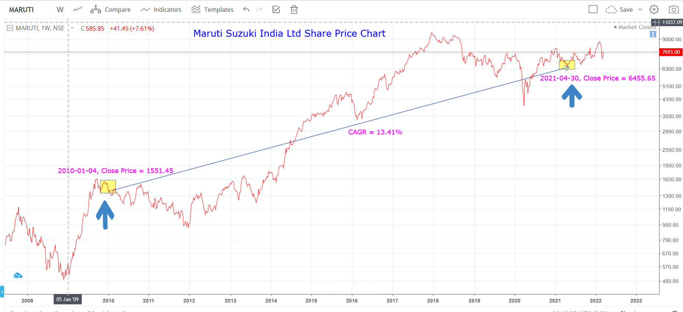
MARUTI SUZUKI CAGR

Slide 22
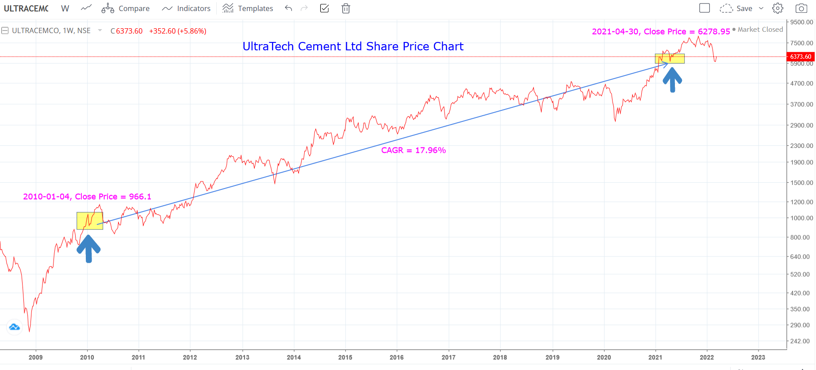
ULTRATECH CEMENT CAGR

Slide 23
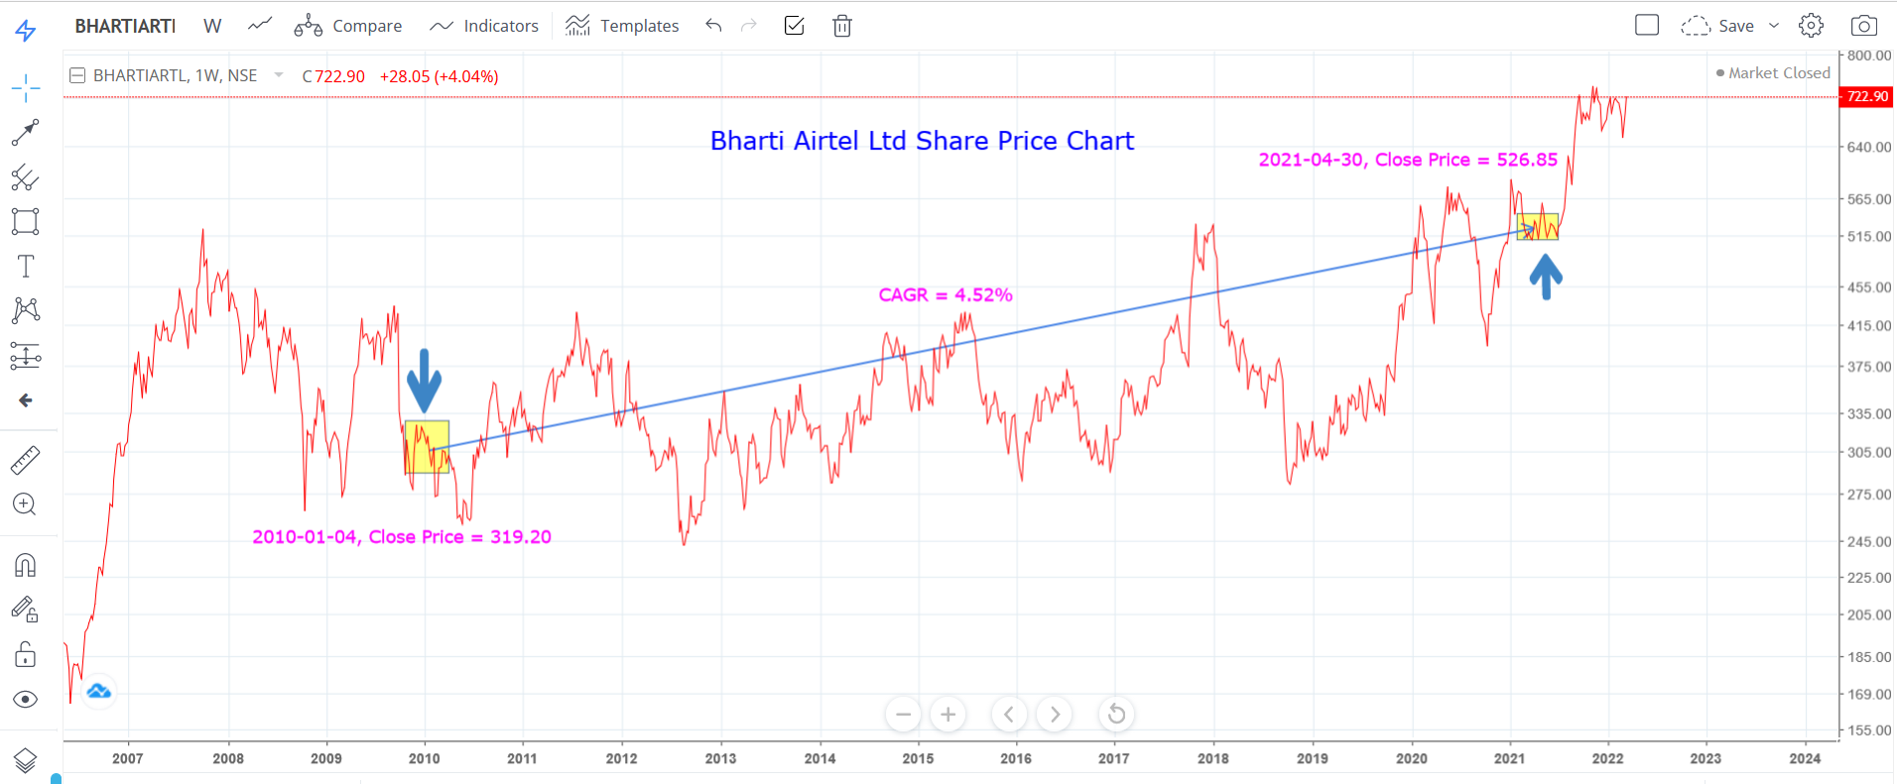
BHARTI AIRTEL CAGR

Slide 24
MAXIMUM VOLUME MONTH
Month where volume was highest
INSIGHTS-
Bharti Airtel – FEBRUARY, 2021
UltraTech Cement – November, 2016
Maruti Suzuki – November, 2015

Slide 25
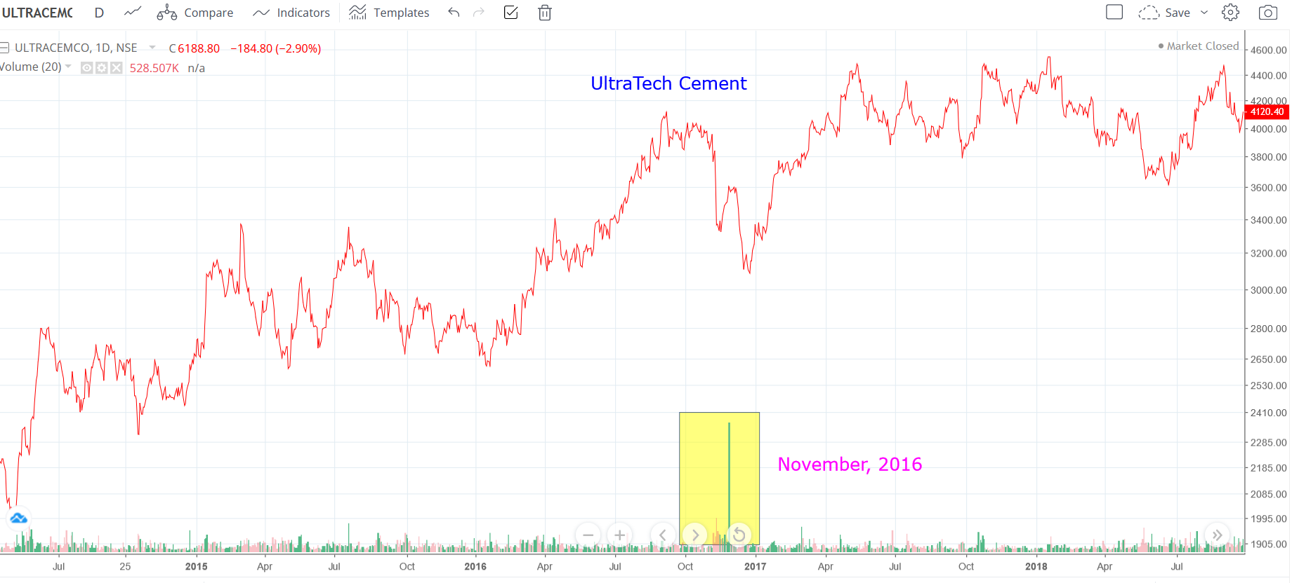
ULTRATECH CEMENT Highest Volume Month

Slide 26
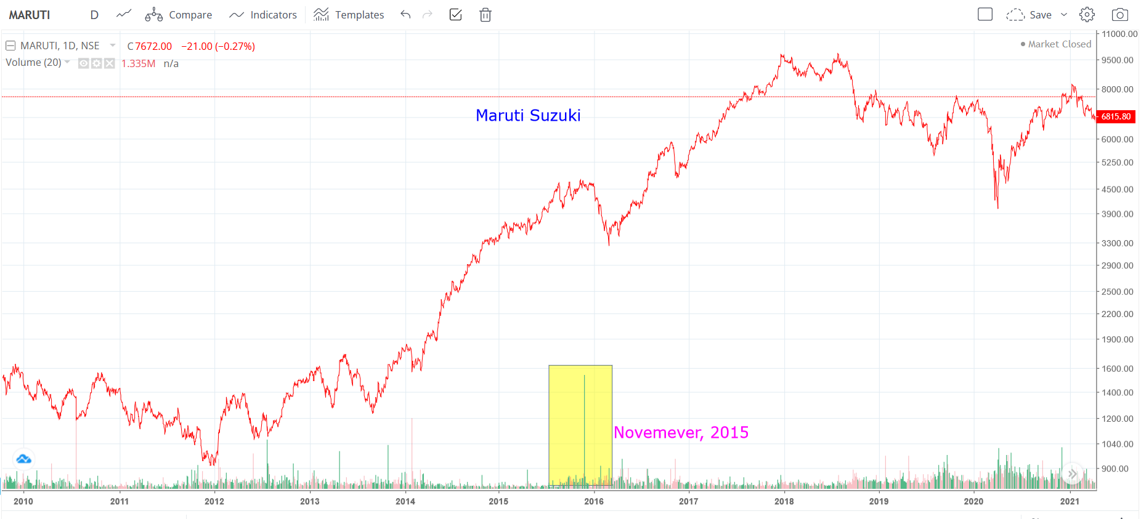
Maruti Suzuki Highest Volume Month

Slide 27
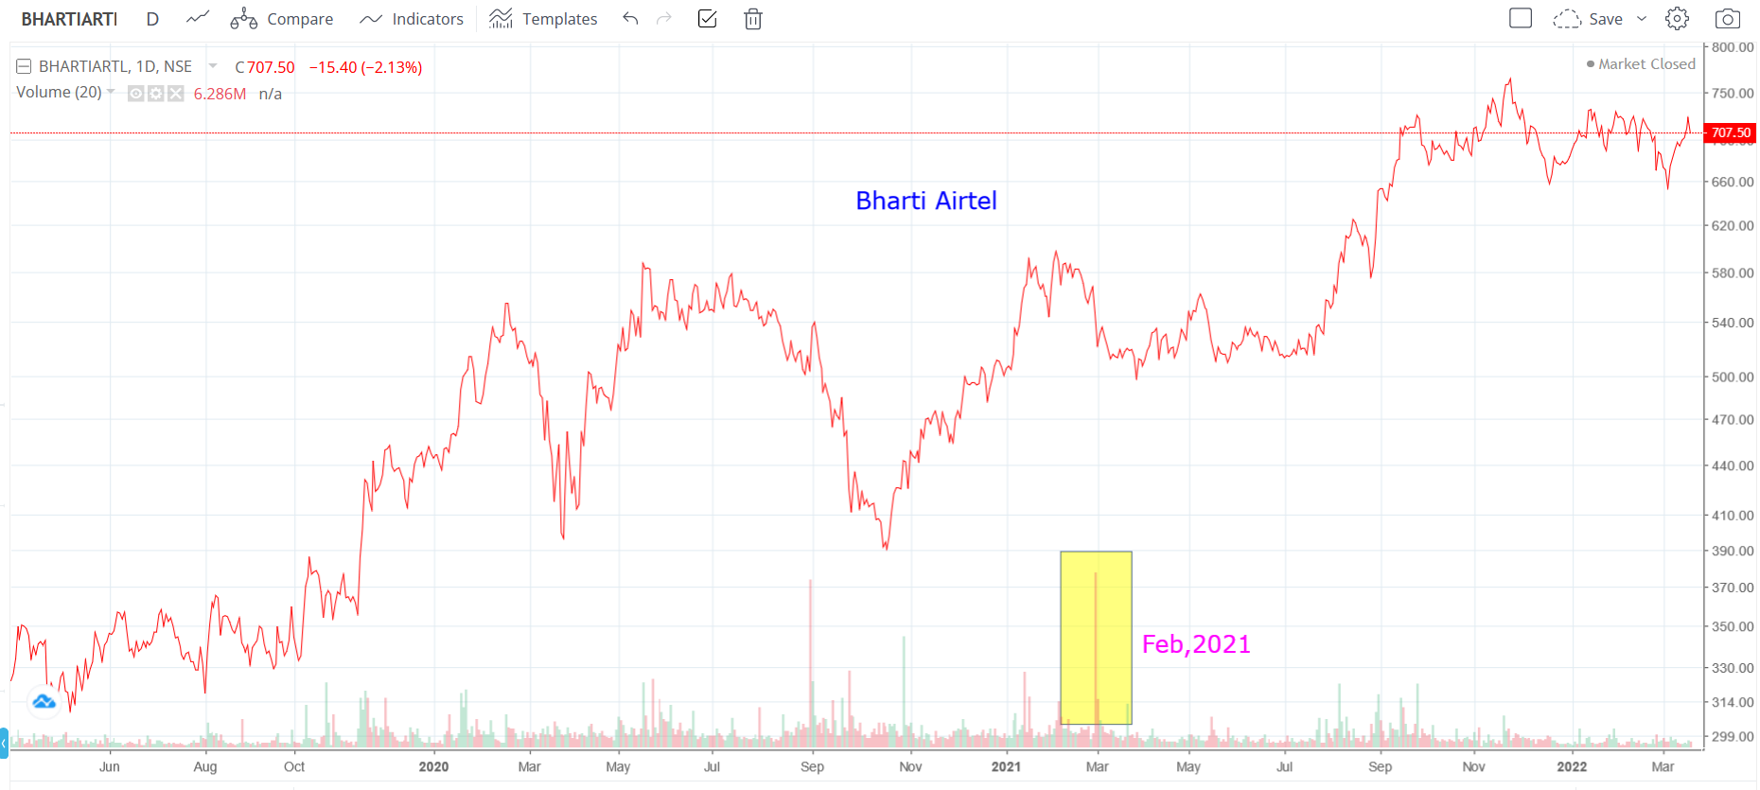
Bharti Airtel Highest Volume Month

Slide 28
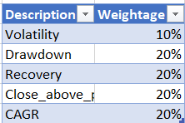
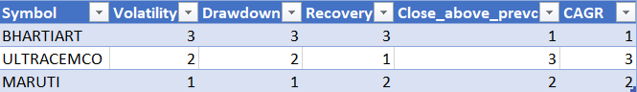
WEIGHTAGES AND FINAL SCORE
Weightages
Individual Score

Slide 29
FINAL SCORE

Slide 30


